Slide 1
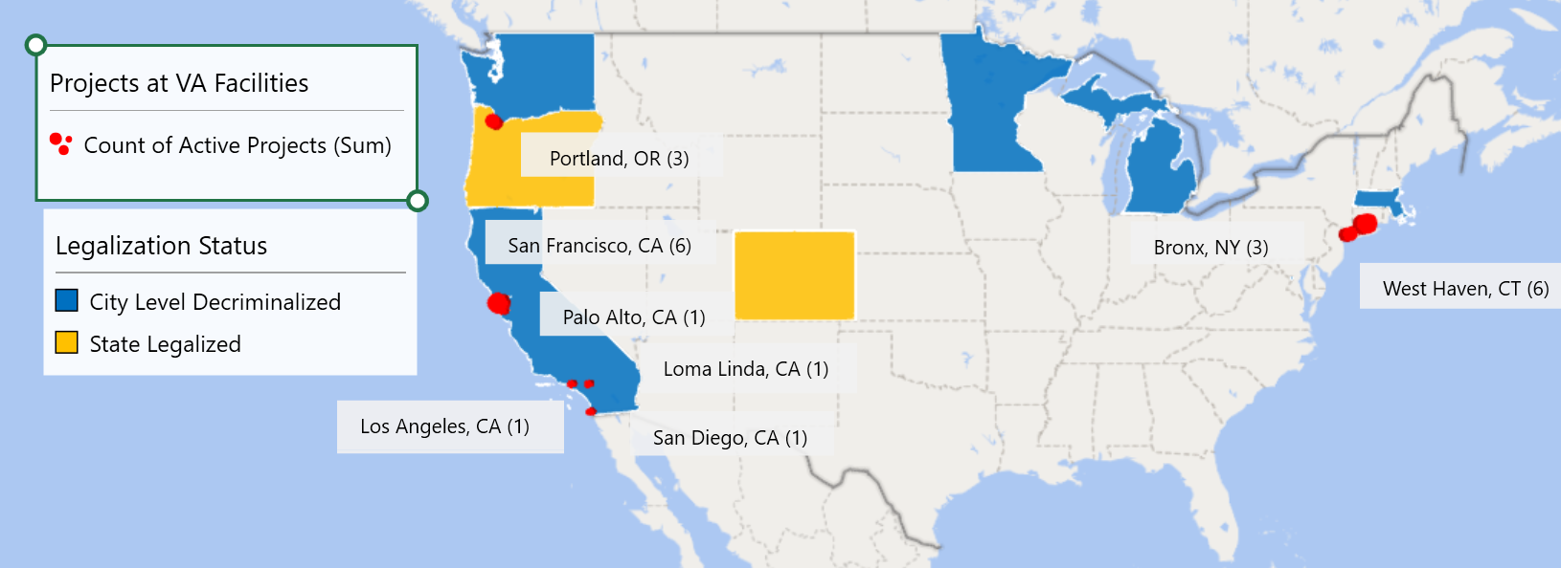
Psychedelic Legalization Status & Location and Number of Psychedelic Projects Active at VA Facilities
Notes:
West Haven, Connecticut 6
San Francisco, California 6
Portland, Oregon 3
Bronx, New York 3
San Diego, California 1
Loma Linda, California 1
Palo Alto, California 1
Los Angeles, California 1
Grand Total 22

